Slide 1
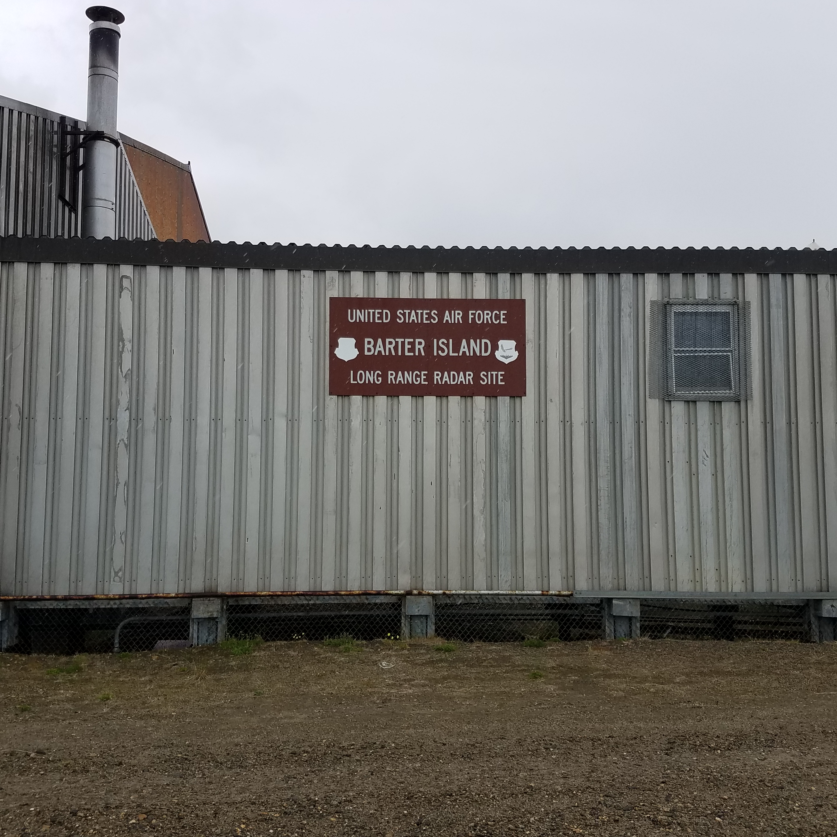


Proposed Plan For
New CERCLA Landfill
Barter Island LRRS
Published February 2021
Virtual Public Meeting
April 27, 2021
6 pm AKDST
Click here to join the
Virtual Public Meeting

Slide 2
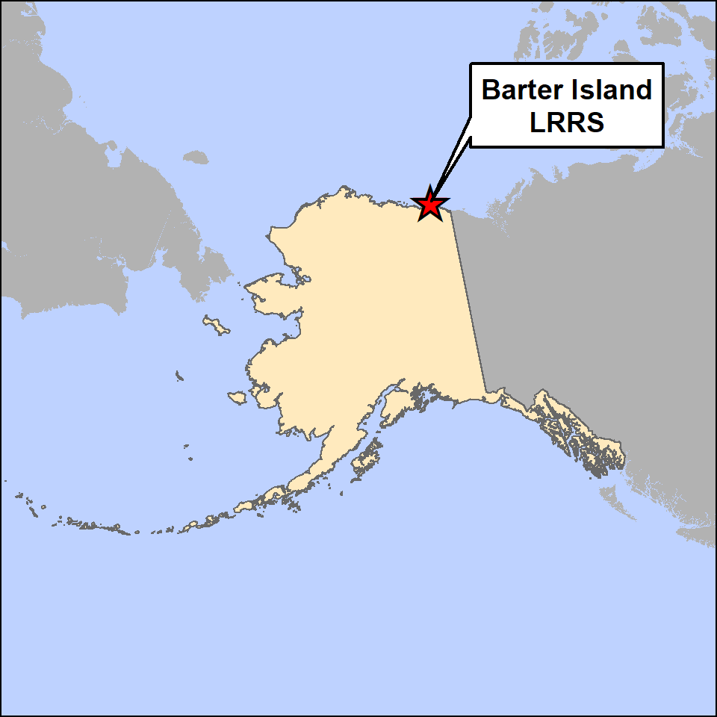
New CERCLA Landfill Proposed Plan | Published February 2021
The USAF provides this Proposed Plan* for the
New CERCLA Landfill at Barter Island LRRS. The purpose of this Proposed Plan is to:
  provide site background information,
  identify the preferred remedial alternative and reasons for its selection,
  describe the other remedial alternatives considered,
  solicit public review and comment on alternatives considered and preferred, and
  provide information on how the public can be involved in the remedy selection process.
*For a copy of the Final Proposed Plan, click here
Notes:
USAF = United States Air Force
CERCLA = Comprehensive Environmental Response, Compensation, and Liability Act
LRRS = Long Range Radar Site

Slide 3
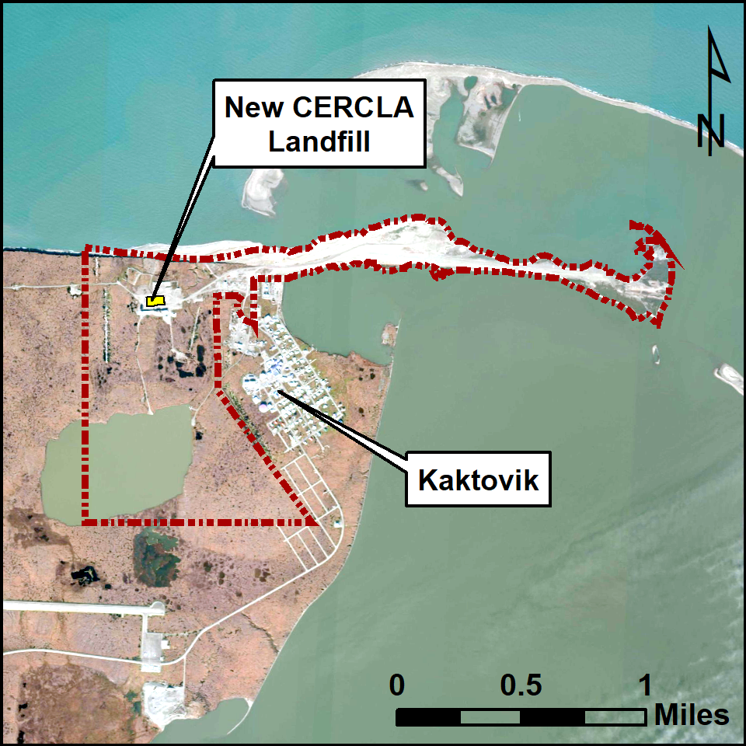
New CERCLA Landfill Site Background
Located within an existing gravel pad north of the Module Train area, the 2.25-acre landfill was constructed in 2008 for a one-time disposal of wastes removed from former LF001 and select demolition debris from Clean Sweep activities.
The landfill was designed to contain wastes in two distinct waste cells, A and B:
  Waste Cell A: 7,070 CY of soil and debris with DRO, RRO and PCB concentrations below regulatory cleanup levels, and
  Waste Cell B: 20,655 CY of soil and debris with DRO and RRO below regulatory cleanup levels, and PCB concentrations above regulatory cleanup level.
Notes:
CY = cubic yards
DRO = diesel range organics
RRO = residual range organics
PCB = polychlorinated biphenyl

Slide 4
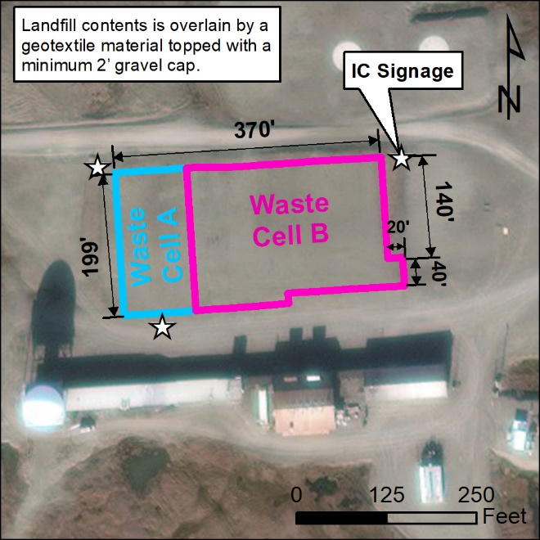
New CERCLA Landfill Site Background (continued)
  The applicable regulatory cleanup level for PCB contamination in soil is the ADEC Table B1 Method Two value of 1 mg/kg, based upon 18 AAC 75.
  The New CERCLA Landfill was surveyed and capped with approximately 2 to 3 ft of clean gravel material upon closure.
  Although not a permitted landfill, visual inspections were conducted annually from 2010 to 2016 to satisfy ADEC post-closure monitoring requirements.
  Interim landfill inspections have been implemented until a final remedy is in place for the New CERCLA Landfill.
Notes:
ADEC = Alaska Department of Environmental Conservation
mg/kg = milligrams per kilogram
AAC = Alaska Administrative Code
ft = feet

Slide 5
Risk Evaluation
The landfill is not considered susceptible to potential erosional impacts from the Beaufort Sea approximately 750 ft to the north.
The landfill is located on USAF property and not located in an area used by village residents for subsistence activities.
PCBs remain the only contaminant of concern onsite with concentrations above regulatory cleanup levels, and are the primary focus for evaluation of risk.
Based upon site observations and historic information there is no potential for occupants to become exposed to contaminants through the consumption of local plants or animals.
There are no current or planned site residents. This portion of the LRRS facility will remain inactive, and interim LUCs are in place within the LUCMP to prevent exposure to contaminants within the landfill.
Notes:
LUCs = Land Use Controls
LUCMP = Land Use Control Management Plan

Slide 6
Risk Evaluation (continued)
Potential exposure pathways for the New CERCLA Landfill are limited by the 2 to 3 ft of clean gravel fill that prevents direct exposure, and the shallow permafrost and absence of groundwater that prevent migration.
In the case that the landfill cap was not maintained and surface erosion was to occur, seasonal surface water runoff and limited porewater transport would have the potential to allow offsite migration of exposed soil and sediment contaminated with PCBs.
A NAUL will be determined by a ROD, and recorded in the Alaska land records to prevent residential land use or development.
The Preferred Remedial Alternative, or one of the other active measures considered in this Proposed Plan, is necessary to protect public health and welfare of the environment from an actual or threatened release.
Notes:
NAUL = notice of activity and use limitation
ROD = Record of Decision

Slide 7
Preferred Remedial Alternative
In accordance with CERCLA, the proposed remedy is to leave the landfill contents in place, with measures to ensure continued protection of human health and the environment. These protective LTM measures include:
  annual maintenance, inspection and reporting,
  a FYR process with periodic porewater monitoring, and
  implementation of LUCs and ICs such as a landfill cap and signage.
  Interim LUCs have been established under the LUCMP for Barter Island to prevent human and ecological exposure of contaminants within the New CERCLA Landfill.
With proper maintenance, the landfill cap consisting of a geotextile fabric and minimum of 2 to 3 ft of clean gravel fill placed atop the landfill contents, and continuous permafrost beneath, will continue to inhibit migration of contaminants and remove the risk of exposure to marine and terrestrial receptors.
Notes:
LTM = Long Term Monitoring
FYR = Five Year Review
ICs = institutional controls

Slide 8


Public Participation
Please direct written (mail or email) and
verbal (phone) comments to:
Mr. Stephen Krause
U.S. Air Force Remedial Project Manager, AFCEC/CZOP
10471 20th Street, Suite 348
JBER, Alaska 99506
Phone: (907) 552-1526
USAF Toll Free: 1-800-222-4137
E-Mail: Stephen.Krause.2@us.af.mil
PUBLIC COMMENTS
  Your comments are welcomed March 15 - April 15, 2021.
  A virtual public meeting will be held to share comments, questions and ideas live.
  See the next slide for the meeting date, time, and how to join.
CONTACT

Slide 9
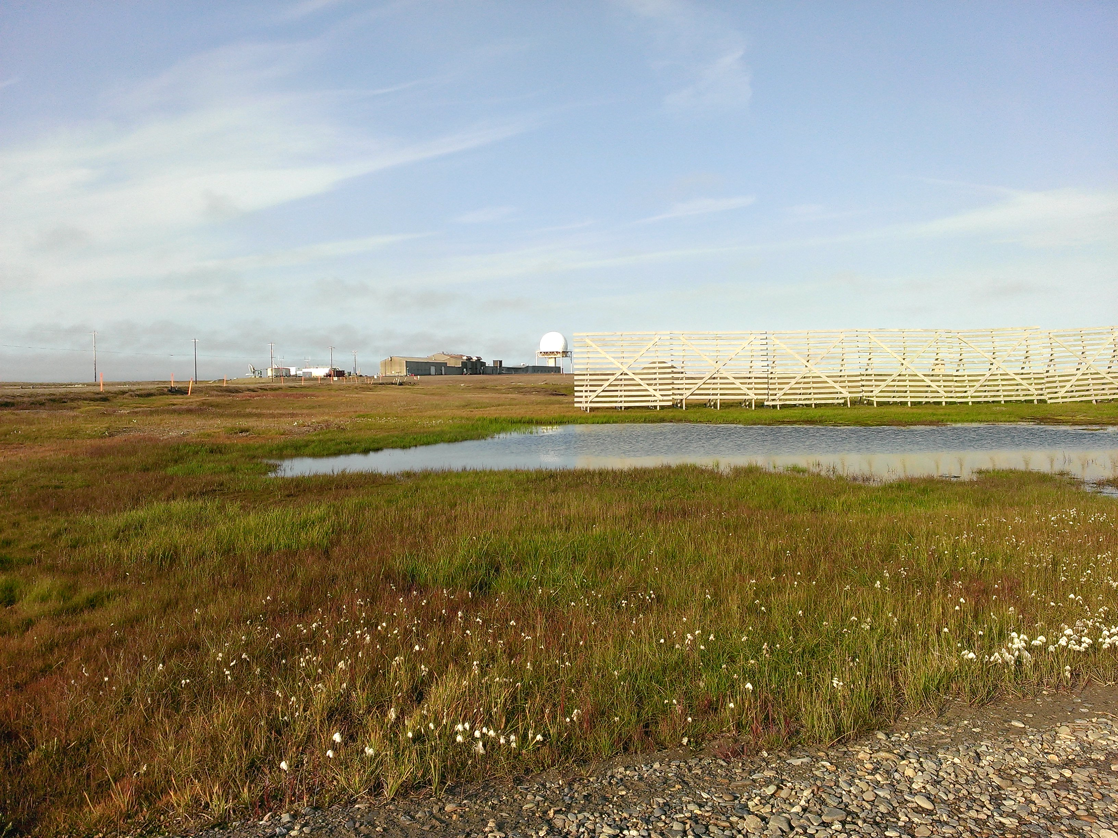
Virtual Public Meeting
April 27, 2021
6 pm
AkDST
Click here to join the
Virtual Public Meeting
Notes:
AKDST = Alaska Daylight Saving Time

